Slide 1

Gencyber2021 Cybersecurity Profession
Larry Wilson, MS.
July 20, 2021
(11:00 – 11:45 am)
Notes:
Good morning, everyone. I am Larry Wilson, Adjunct Professor in Computer Science / Cybersecurity Studies at UML. So excited to be here today.

Slide 2
About me: Larry Wilson … CISSP, CISA
Full time Cybersecurity Practitioner
Worcester Polytechnic Institute – Chief Information Security Officer (CISO)
UMass President’s Office – Chief Information Security Officer (CISO)
Cybersecurity Consulting- Conduct Security Assessments & Recommend Program Improvements
Colleges and Universities in Massachusetts, Rhode Island, New Hampshire
Several Government – Department of Defense, Department of State
Private Companies –Biotech Industry, Manufacturing Industry, Financial Services Industry
Adjunct Professor - Computer Science / Cybersecurity
University of Massachusetts Lowell
USAA Insurance
Secure World Cybersecurity Conferences
Cybersecurity Certifications
ISC2 - Certified Information Systems Security Professional (CISSP)
ISACA - Certified Information Systems Auditor (CISA)
Notes:
I have 20 years experience in the Cybersecurity Profession – My experience includes full-time practitioner (Higher Education, Financial Services), professional

Slide 3
Today’s Objectives / Agenda
Cybersecurity Profession
Current Job Market for Cybersecurity Professionals … Cybersecurity Career Profiles
Knowledge, Skills, Abilities (KSAs) for Cybersecurity Workforce … National Cyber League (NCL) Skills
Industry Certifications for Cybersecurity Professionals
Key Takeaways and References
Notes:
Today we are going to learn about and discuss “Cybersecurity Profession”.
Objectives of today’s session are following:
Learn about current job market (Massachusetts and US)
Learn about required KSAs for today’s jobs
Learn about industry certifications
Discuss key takeaways and references

Slide 4
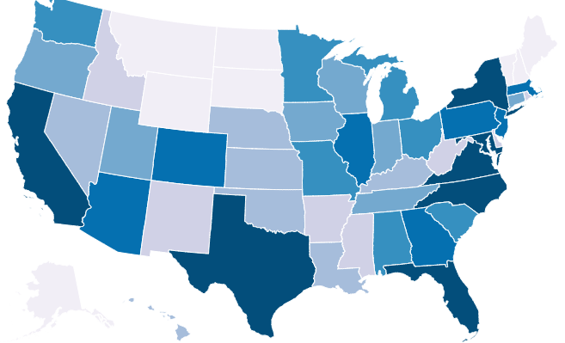
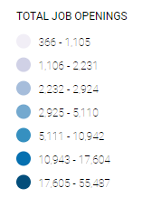
Current Job Market Source: Cyber Seek Interactive Map
Cyber Seek provides detailed, actionable data about supply and demand in the cybersecurity job market.
https://www.cyberseek.org/
Notes:
Cyber Seek can support local employers, educators, guidance and career counselors, students, current workers, policy makers, and other stakeholders

Slide 5
Massachusetts Job Openings
Total Cybersecurity Job Openings = 13,389
Total Employed Cybersecurity Workforce = 23,615
Supply of Cybersecurity Workers = Very Low
National Average for all Jobs = 3.9
Massachusetts Market for Cybersecurity = 1.8
Cybersecurity Job Titles: Top Titles Requested by Employers
Cyber Security Analyst
Cyber Security Engineer
Systems Security Manager
Software Developer
Network Engineer / Architect
Vulnerability Analyst / Penetration Tester
Cyber Security Specialist / Technician
Incident Analyst / Responder
https://www.cyberseek.org/
Notes:
Cyber Seek is a

Slide 6
Job Title: Systems Security Manager
Planning
Building
Operating
Degree Required: Yes
Bachelor’s Degree in Cybersecurity or Computer Science
Median Salary: $ 110 K
Job Growth: 20%
Common Job Duties:
Manage organizational resources (time, money, personnel, etc.) to support security goals and policies
Create and execute strategies to improve the reliability and security of IT projects
Define, implement and maintain corporate security policies and procedures
Spearhead vulnerability audits, forensics, investigations and mitigation procedures
Manage a diverse team of security administrators, analysts and IT professionals
Advise leadership on organization’s cybersecurity status
Institute organization-wide training in security awareness, protocols and procedures
Assess, test and select new security products and technologies
https://niccs.cisa.gov/sites/default/files/documents/pdf/career%20profiles5.pdf?trackDocs=career%20profiles5.pdf

Slide 7
Job Title: Cyber Security Engineer
Planning
Building
Operating
Degree Required: Yes
Bachelor’s Degree in Cybersecurity or Computer Science
Median Salary: $ 90 K
Job Growth: 20%
Common Job Duties:
Create new ways to solve existing production security issues
Configure and install firewalls and intrusion detection systems
Perform vulnerability testing, risk analyses and security assessments
Develop automation scripts to handle and track incidents
Collaborate with colleagues on authentication, authorization and encryption solutions
Evaluate new technologies and processes that enhance security capabilities
Test security solutions using industry standard analysis criteria
Respond to information security issues during each stage of a project’s lifecycle
https://niccs.cisa.gov/sites/default/files/documents/pdf/career%20profiles5.pdf?trackDocs=career%20profiles5.pdf

Slide 8
Job Title: Software Developer
Planning
Building
Operating
Degree Required: Yes
Associates Degree. A Bachelors or Masters in Computer Science is encouraged
Median Salary: $ 70 K
Job Growth: 24%
Common Job Duties:
Develops, creates, maintains and writes / codes computer applications, software, or utility programs
Design, implement, and test software
Assist in the development of a company-wide software security strategy
Facilitate meetings and workshops to define client processes and needs
Create new software systems or forensics tools
Participate in the lifecycle development of software systems using different methodologies
Design and build proof-of-concept prototype software
Institute programming techniques that are free from logical design and technical implementation flaws
Gain a thorough knowledge of attack vectors that may be used to exploit software
Support software deployments to customers
https://niccs.cisa.gov/sites/default/files/documents/pdf/career%20profiles5.pdf?trackDocs=career%20profiles5.pdf

Slide 9
Job Title: Vulnerability Analyst
Planning
Building
Running
Degree Required: No
Real-world experience is much more valued than a degree, though a degree won’t hurt
Median Salary: $ 75 K
Job Growth: 20%
Common Job Duties:
Identify critical flaws in applications and systems that cyber attackers could exploit
Conduct vulnerability assessments for networks, applications and operating systems
Conduct network security audits and scanning on a predetermined basis and policies
Use automated tools (e.g., Nessus) to pinpoint vulnerabilities and reduce time-consuming tasks
Use manual testing techniques and methods to gain a better understanding of the environment and reduce false negatives
Develop, test and modify custom scripts and applications for vulnerability testing
Compile and track vulnerabilities over time for metrics purposes
Supply hands-on training for network and systems administrators
https://niccs.cisa.gov/sites/default/files/documents/pdf/career%20profiles5.pdf?trackDocs=career%20profiles5.pdf

Slide 10
Job Title: Incident Responder
Planning
Building
Running
Degree Required: No
Bachelor’s Degree in Cybersecurity or Computer Science is plus
Median Salary: $ 80 K
Job Growth: 20%
Common Job Duties:
Actively monitor systems and networks for vulnerabilities
Identify security flaws and vulnerabilities
Perform security audits, risk analysis, network forensics and penetration testing
Perform malware analysis and reverse engineering
Develop a procedural set of responses to security problems
Establish protocols for communication within an organization and dealings with law enforcement during security incidents
Create program development plan (security gap assessments, policies, procedures, playbooks, training, tabletop testing)
Produce detailed incident reports and technical briefs for management, administrators and end-users
Liaison with other cyber threat analysis entities
https://niccs.cisa.gov/sites/default/files/documents/pdf/career%20profiles5.pdf?trackDocs=career%20profiles5.pdf

Slide 11
Job Title: Cyber Forensics Expert
Planning
Building
Running
Degree Required: Yes
Bachelor’s Degree in Cybersecurity or Computer Science
Median Salary: $ 70 K
Job Growth: 28%
Common Job Duties:
Conduct data breach and security incident investigations
Recover and examine data from computers and electronic storage devices
Dismantle and rebuild damaged systems to retrieve lost data
Identify additional systems / networks compromised by cyber attacks
Compile evidence for legal cases
Draft technical reports, write declarations and prepare evidence for trial
Give expert counsel to attorneys about electronic evidence in a case
Advise law enforcement on the credibility of acquired data
Train law enforcement officers on computer evidence procedures
Keep abreast of emerging technologies, software and methodologies
https://niccs.cisa.gov/sites/default/files/documents/pdf/career%20profiles5.pdf?trackDocs=career%20profiles5.pdf

Slide 12
Test Your Knowledge (1)
Planning
Building
Operating
Who Am I?
I manage organizational resources (time, money, personnel, etc.) to support security goals and policies
I create and execute strategies to improve the reliability and security of IT projects
I define, implement and maintain corporate security policies and procedures
I spearhead vulnerability audits, forensics, investigations and mitigation procedures
I advise leadership on organization’s cybersecurity status
Your Answer is?
Security Engineer
Systems Security Manager
Software Developer

Slide 13
Test Your Knowledge (1)
Planning
Building
Operating
Who Am I?
I manage organizational resources (time, money, personnel, etc.) to support security goals and policies
I create and execute strategies to improve the reliability and security of IT projects
I define, implement and maintain corporate security policies and procedures
I spearhead vulnerability audits, forensics, investigations and mitigation procedures
I advise leadership on organization’s cybersecurity status
Your Answer is?
Security Engineer
Systems Security Manager
Software Developer

Slide 14
Test Your Knowledge (2)
Planning
Building
Running
Who Am I?
I create new ways to solve existing production security issues
I configure and install firewalls and intrusion detection systems
I perform vulnerability testing, risk analyses and security assessments
I develop automation scripts to handle and track incidents
I investigate intrusion incidents, complex forensic investigations and mount incident responses
Your Answer is?
Security Engineer
Vulnerability Assessment
Software Developer

Slide 15
Test Your Knowledge (1)
Planning
Building
Running
Who Am I?
I create new ways to solve existing production security issues
I configure and install firewalls and intrusion detection systems
I perform vulnerability testing, risk analyses and security assessments
I develop automation scripts to handle and track incidents
I investigate intrusion incidents, complex forensic investigations and mount incident responses
Your Answer is?
Security Engineer
Vulnerability Assessment
Software Developer

Slide 16
The National Cyber League (NCL)
Enables high school and college students across the U.S. to prepare and test themselves against practical cybersecurity challenges they will likely face in the workforce.
More than 10,000 students and 550 institutions participate each year
The $35 registration fee includes access to everything in the Season Schedule
Needed for a school to participate: faculty coach, student players, standard computers, an Internet connection
A faculty coach is a staff member of the school or university who acts as an official point of contact for student players from that school or university.
A faculty coach is not required for student players to participate in the NCL. Students players may simply register for the NCL and participate with other friends and classmates.
https://www.youtube.com/watch?v=MFz7UV37jbI

Slide 17
The National Cyber League (NCL) Competition
NCL Overview
NCL hosts two seasons every year, once in the Spring and once in the Fall, aligning to US Academic Calendars.
All participants play games simultaneously during Preseason, Individual Game, and Team Game.
NCL allows players of all levels to play.
Between easy, medium and hard challenges, students have multiple opportunities to really shine in areas as they excel.
Fall 2021 Season Schedule
Registration Opens: August 23
Gym Open: August 23 - December 17
Preseason Game: October 11-18
Individual Game: October 22-24
Team Game: November 5-7
https://cyberskyline.com/events/ncl/info

Slide 18
The NCL Categories & Skills: Open Source Intelligence / Cryptography
Open Source Intelligence
By gathering publicly available information about a particular target, attackers can profile potential victims to find vulnerabilities.
Without actively engaging the target, an attacker can use the intelligence to build a threat model and develop a plan of attack.
Targeted cyber attacks, like military attacks, begin with reconnaissance, and the first stage of digital reconnaissance is passively acquiring intel without alerting the target.
Cryptography
Decipher hidden messages through the NCL games to learn what is really going on.
Learn how to identify techniques used to encrypt or obfuscate messages and leverage tools to extract the plain text.
Millions of secure encoded transmissions happen online every day, and cryptographic standards are used to protect governments, industry and individuals.
https://static1.squarespace.com/static/5e13a4b584a68c775e362068/t/5f3ec0067388003a3d3c6252/1597947910523/NCL-NICE6+w+icons.pdf

Slide 19
The NCL Categories & Skills: Password Cracking / Log Analysis
Password Cracking
Try your hand at cracking passwords through the NCL games.
Identify types of password hashes and apply various techniques to efficiently determine plain text passwords.
Having comprehensive password cracking expertise arms cybersecurity workers to implement better cyber awareness and password creation practices, while identifying the source of attacks more quickly.
Log Analysis
Analyze the logs to figure out what the hackers have been up to.
Use the proper tools and techniques to establish a baseline for normal operation and identify malicious activities through log files from various services.
This process helps businesses comply with security policies, audits or regulations, comprehend system troubleshoots, and understand online user behavior.
https://static1.squarespace.com/static/5e13a4b584a68c775e362068/t/5f3ec0067388003a3d3c6252/1597947910523/NCL-NICE6+w+icons.pdf

Slide 20
The NCL Categories & Skills: Traffic Analysis / Forensics
Traffic Analysis
Determine what happened and exactly when it happened by looking at network traffic capture.
Identify malicious and benign network traffic and demonstrate your understanding of potential security breaches.
Network traffic analysis (NTA) is the process of intercepting, recording and analyzing network traffic communication patterns in order to detect and respond to security threats.
Forensics
Challenge yourself to become a digital Sherlock and investigate computer-related crimes and evidence!
Forensics techniques can uncover important data that was lost or damaged in a breach.
You’ll have the tools to identify critical pieces of evidence for unearthing the adversary or determining exactly what was stolen in an incident.
https://static1.squarespace.com/static/5e13a4b584a68c775e362068/t/5f3ec0067388003a3d3c6252/1597947910523/NCL-NICE6+w+icons.pdf

Slide 21
The NCL Categories & Skills: Web Application Exploitation / Scanning
Web Application Exploitation
Find and demonstrate vulnerabilities in various systems. Practice using the vulnerabilities to bypass security measures in online services.
Websites and web application coding may be vulnerable, allowing attackers to gain some level of control of the site, and possibly the hosting server itself.
Hackers exploit vulnerabilities to steal data, distribute malicious content, or steal customer information. Understanding how weaknesses help hackers is the first step to defending websites.
Scanning
Practice and apply the proper tools to gain intelligence about a hacker’s potential target including its services and potential vulnerabilities.
Networks (including any device with an IP address) should be scanned at least monthly to identify and remediate vulnerabilities.
People running a scan should have a background in networking, knowledge on scanning tools, and understand a wide range of vulnerabilities and ways they can be exploited.
https://static1.squarespace.com/static/5e13a4b584a68c775e362068/t/5f3ec0067388003a3d3c6252/1597947910523/NCL-NICE6+w+icons.pdf

Slide 22
The NCL Categories & Skills: Enumeration / Exploitation
Enumeration & Exploitation
Identify actionable exploits and vulnerabilities and use them to bypass the security measures in code and compiled binaries.
Enumeration is the process of establishing an active connection to the target hosts to discover potential attack vectors in a system.
Hackers gather information including user names, host names, network sharing and services, IP tables and routing tables, service settings, audit configurations, applications and other details.
The outcome of enumeration, which is often considered a critical phase in penetration testing, can be used directly to exploit the system.
https://static1.squarespace.com/static/5e13a4b584a68c775e362068/t/5f3ec0067388003a3d3c6252/1597947910523/NCL-NICE6+w+icons.pdf

Slide 23
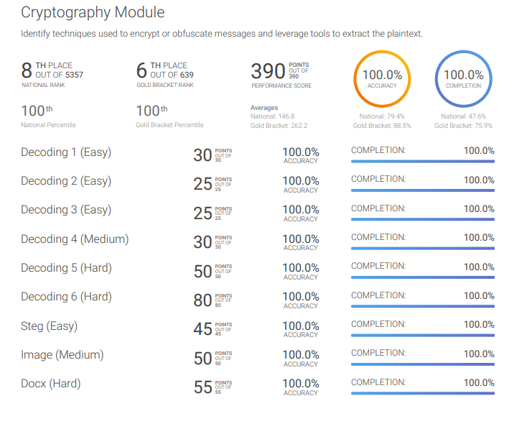
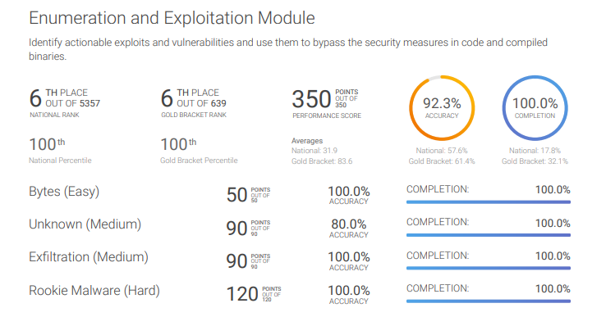
NCL Scouting Report: Cryptography, Enumeration & Exploitation

Slide 24
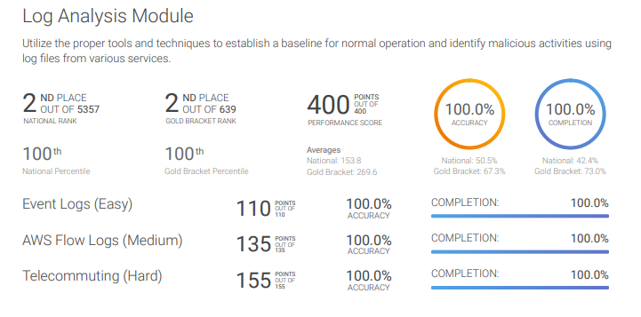
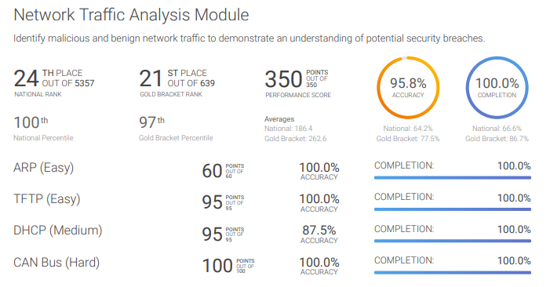
NCL Scouting Report: Log Analysis and Network Traffic Analysis

Slide 25
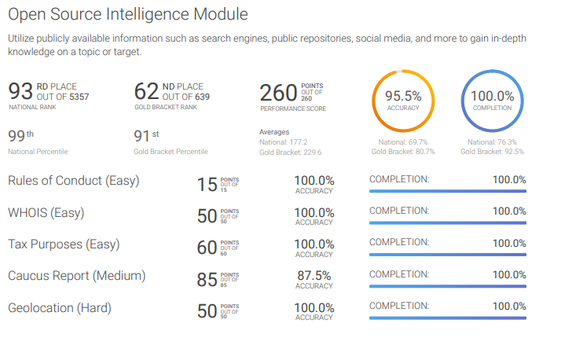
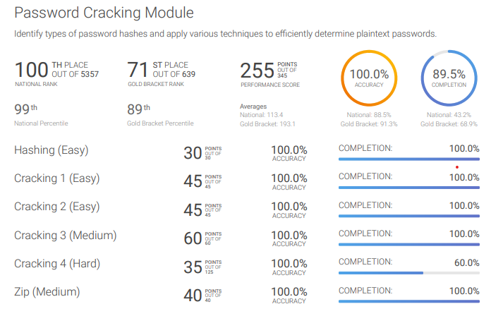
NCL Scouting Report: Open Source Intelligence & Password Cracking

Slide 26
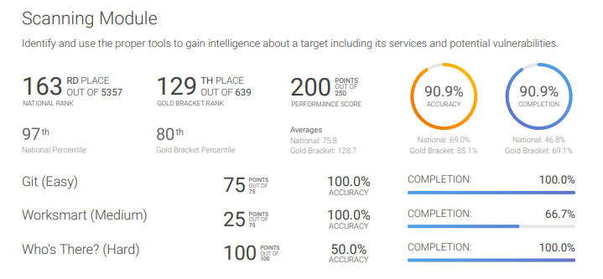
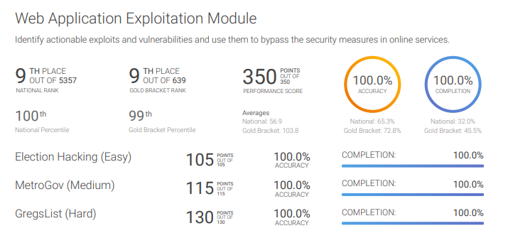
NCL Scouting Report: Scanning & Web Application Exploitation
Notes:
Cyber Seek is a

Slide 27
Top Cybersecurity Certifications
Security+
CompTIA Security+ is a global certification that validates the baseline skills necessary to perform core security functions and pursue an IT security career. CompTIA Security+ is the first security certification a candidate should earn. It establishes the core knowledge required of any cybersecurity role and provides a springboard to intermediate-level cyber security jobs.
CISSP:
The CISSP is ideal for experienced security practitioners, managers and executives interested in proving their knowledge across a wide array of security practices and principles
CISA:
CISA is world-renowned as the standard of achievement for those who audit, control, monitor and assess an organization’s information technology and business systems.

Slide 28
Key Takeaways and References
We Covered
Current Job Market for Cybersecurity Professionals
Key Knowledge, Skills, Abilities (KSAs) for Cybersecurity Workforce
Industry Certifications for Cybersecurity Professionals
Now it’s time to take action
Review job market …….. and career choice(s) of interest
Match your current skills / experience ………… to those required based on your career choice(s)
Join the National Cyber League (NCL) Competition …..…… to improve your skills and experience
Consider the Security+ Certification

Slide 29


